Slide 1
Assignment 3 Briefing
Dr. Tan Chee Keong
School of Information Technology

Slide 2
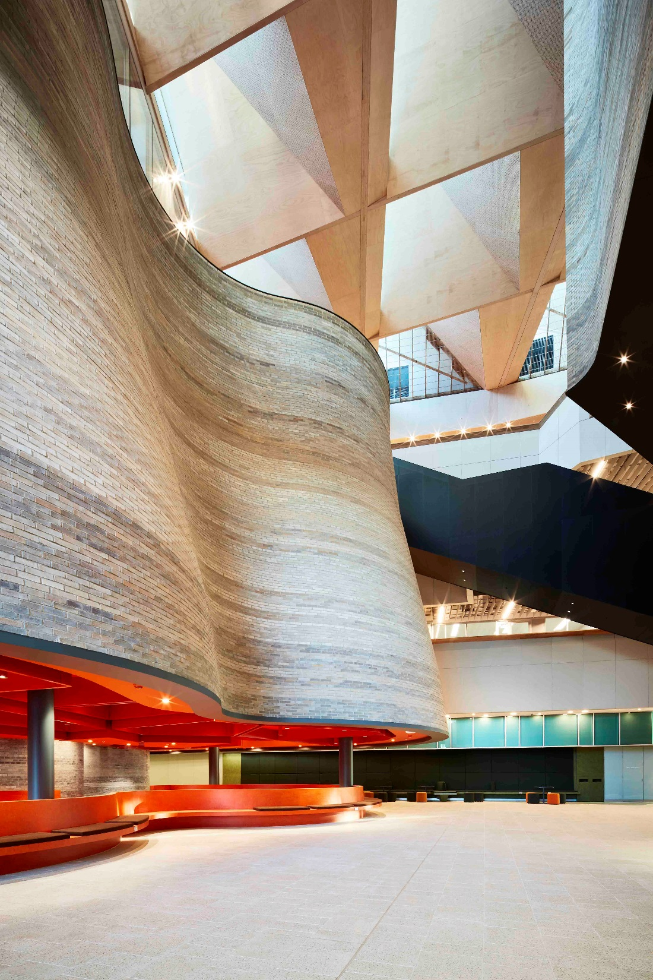
Part 1: WLAN Network Design and Security

Slide 3
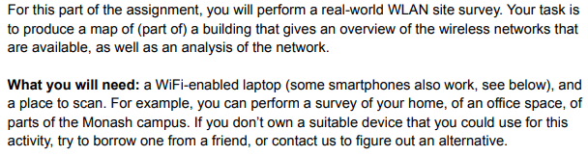

Instructions

Slide 4
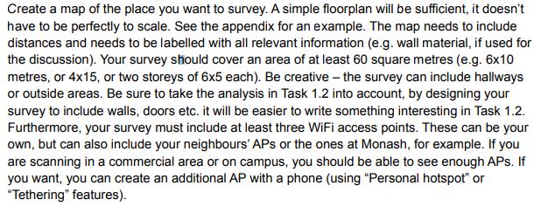
Task 1.1 Survey (15 marks)

Slide 5
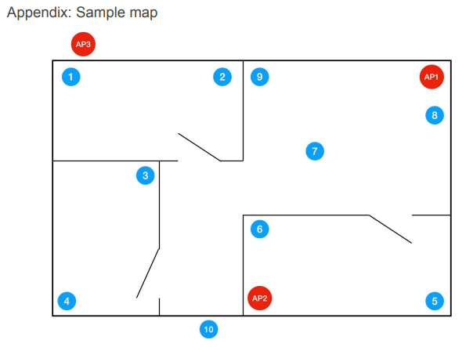
Sample Floor Plan

Slide 6
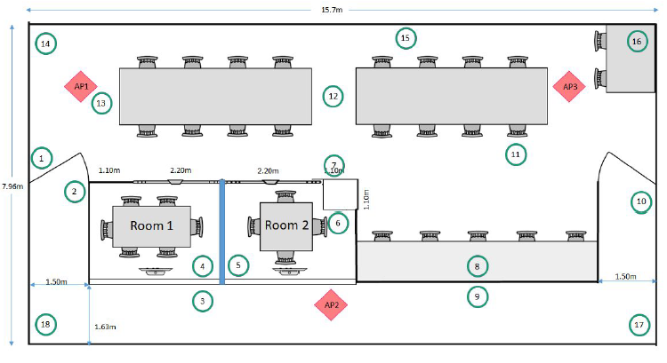
Example: Floor Plan

Slide 7
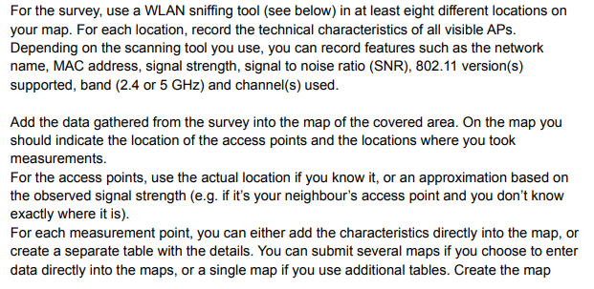
Survey

Slide 8
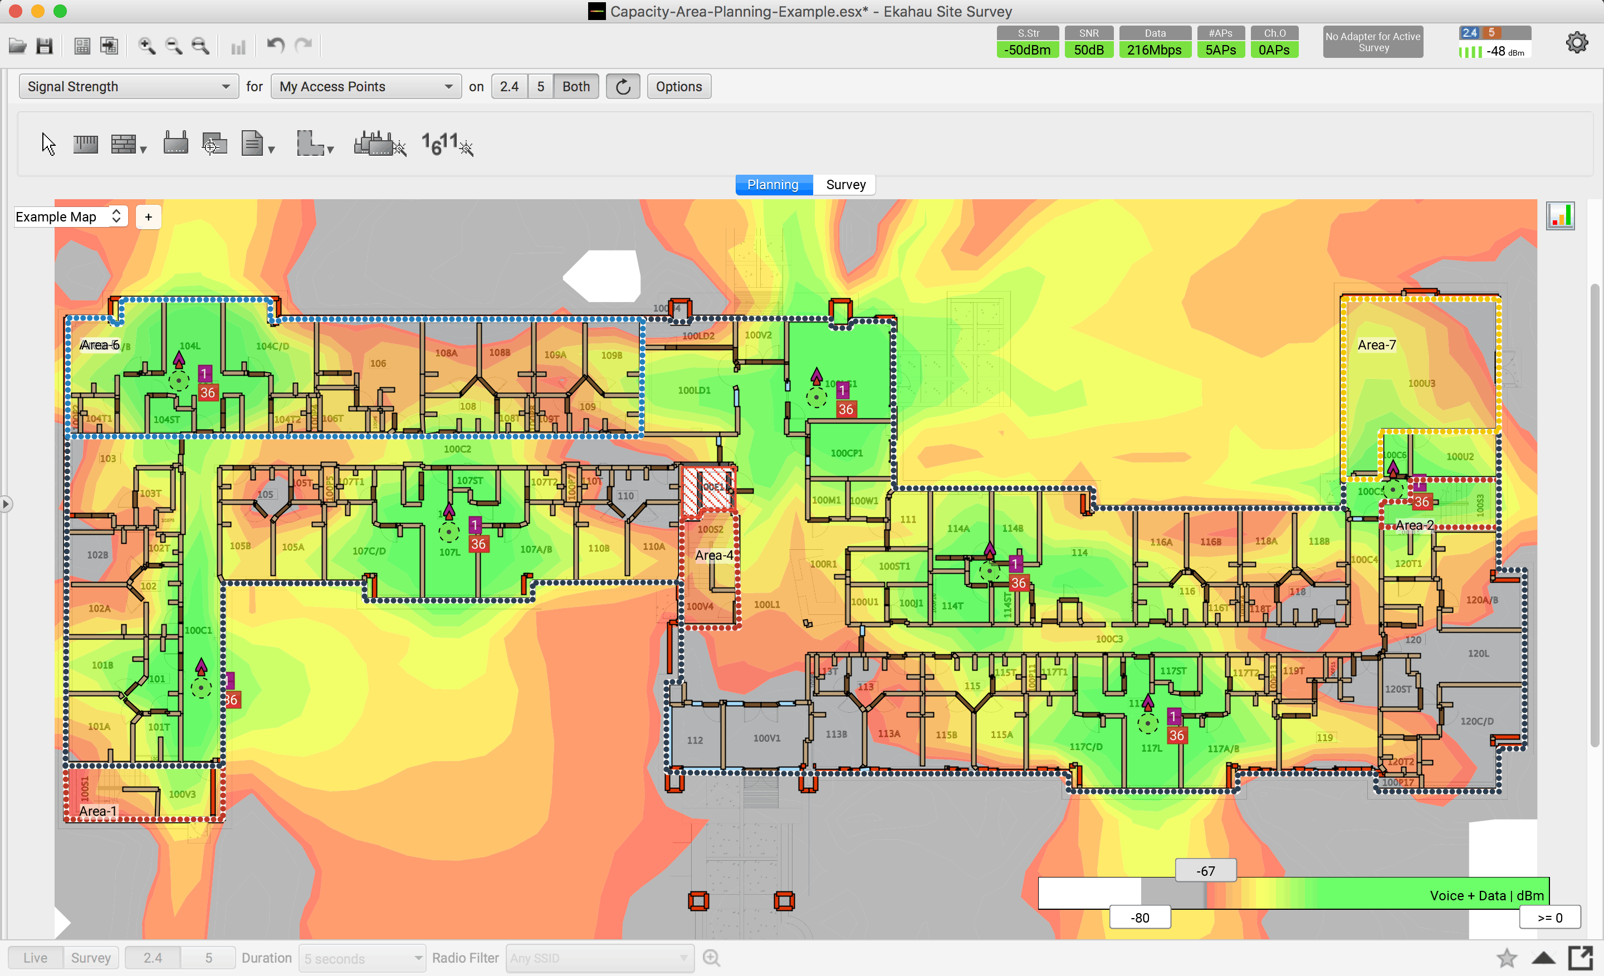
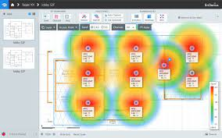
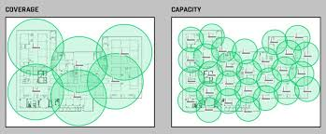
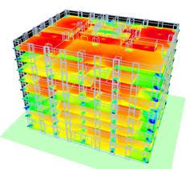
Some Commercial Tools (Not Required)

Slide 9
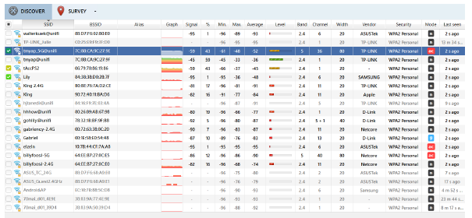
Example: NetSpot (https://www.netspotapp.com/)

Slide 10
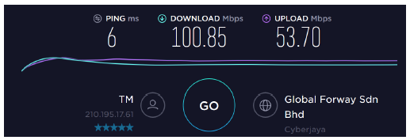
Example: SpeedTest

Slide 11
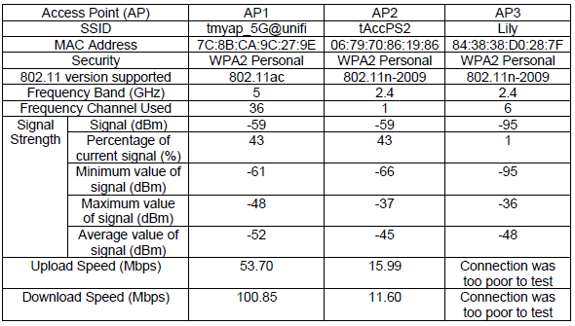
Example: Tabulated Data (At One Test Point)

Slide 12
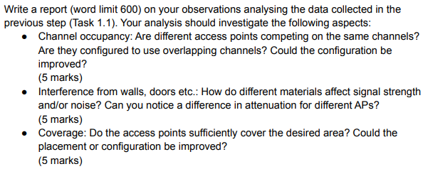
Task 1.2 Report (20 marks)

Slide 13
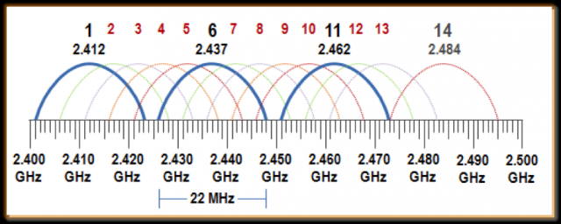
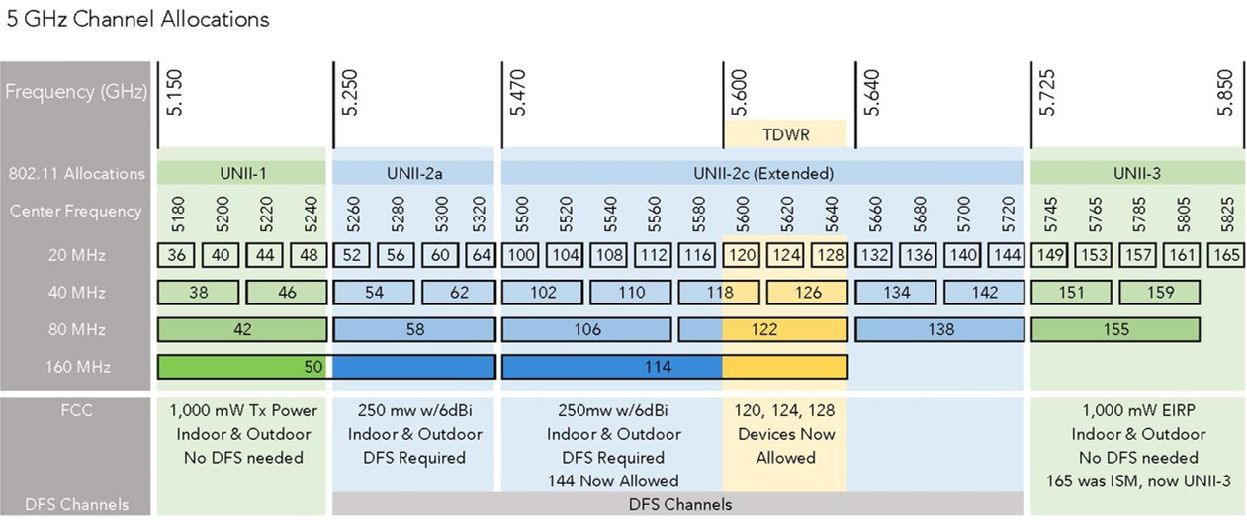
Report
• Channel Occupancy: Are different access points competing on the same channels? Are they configured to use overlapping channels? Is roaming available? Determine the overlap that has been implemented to enable roaming. Etc. (6 marks)

Slide 14
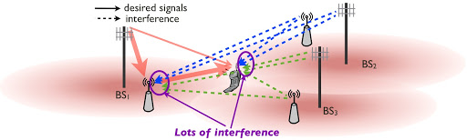
Report
Interference: Effect of other sources of signals (microwave oven, reflected signals from walls, doors etc). (6 marks)

Slide 15
Report
• Attenuation: How does different material affect signal strength and noise? Do you notice any difference in attenuation for different APs? How about attenuation caused by your own body? Can you measure and reflect the result? (6 marks)

Slide 16
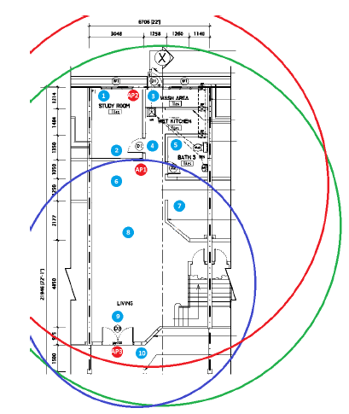
Report
• Coverage: Do the access points sufficiently cover the desired area? Could the placement
or configuration be improved? (6 marks)

Slide 17
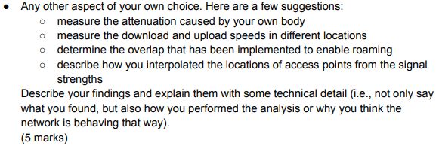
Task 1.2 Report (20 marks)

Slide 18
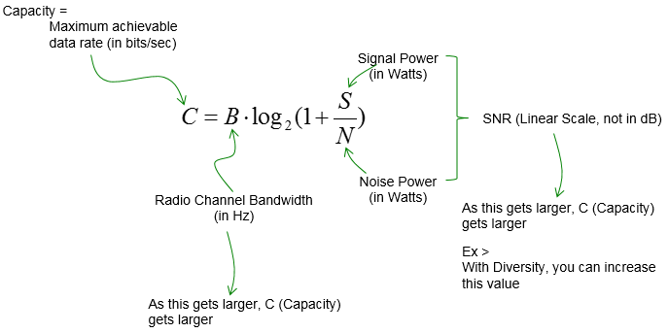
Report
– measure the download and upload speeds in different locations

Slide 19
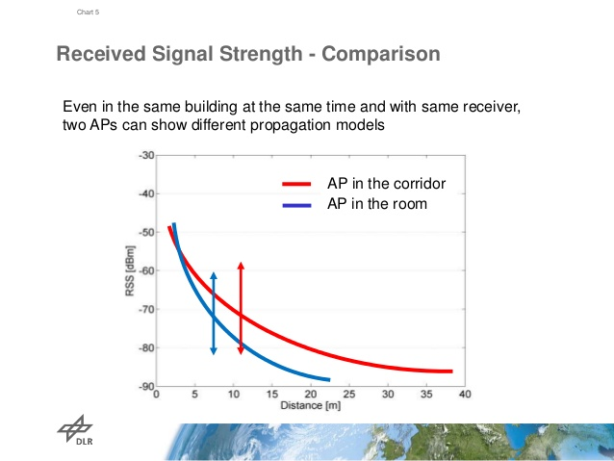
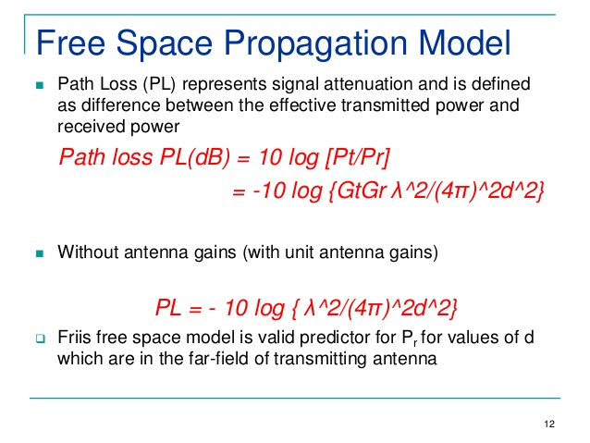
Report
– describe how you interpolated the locations of access points from the signal strengths

Slide 20
Required Components in Documentation
A floor plan showing all APs and test places including the obstacles at your selected premise such as wall, doors, windows, furniture, etc.
A table to show the results of all the required measurements and observations as mentioned in the assignment.
Screenshots of the measurements using software. Multiple screenshots can be collected in the Appendix.
A report including the observations and discussions of the measurements from different aspects as mentioned in the assignment.
Include references wherever needed

